Slide 1
Recipe Recommender System ML Assignment

Slide 2

Tasks Followed for assignment
TASK 2
Collaborative filtering model
TASK 3
TASK 1
Model Evaluation
Train Test Split

Slide 3
TASK 1
Train Test Split

Slide 4
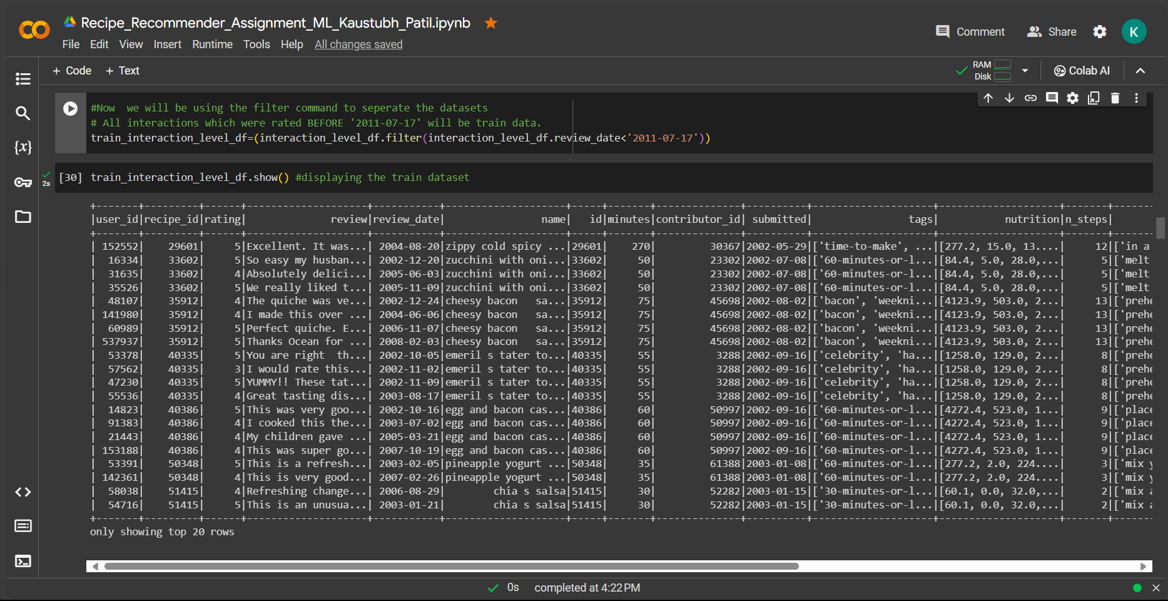
Train Test Split
Output : Performing Train Test Split based on the review date column. This is training Data

Slide 5
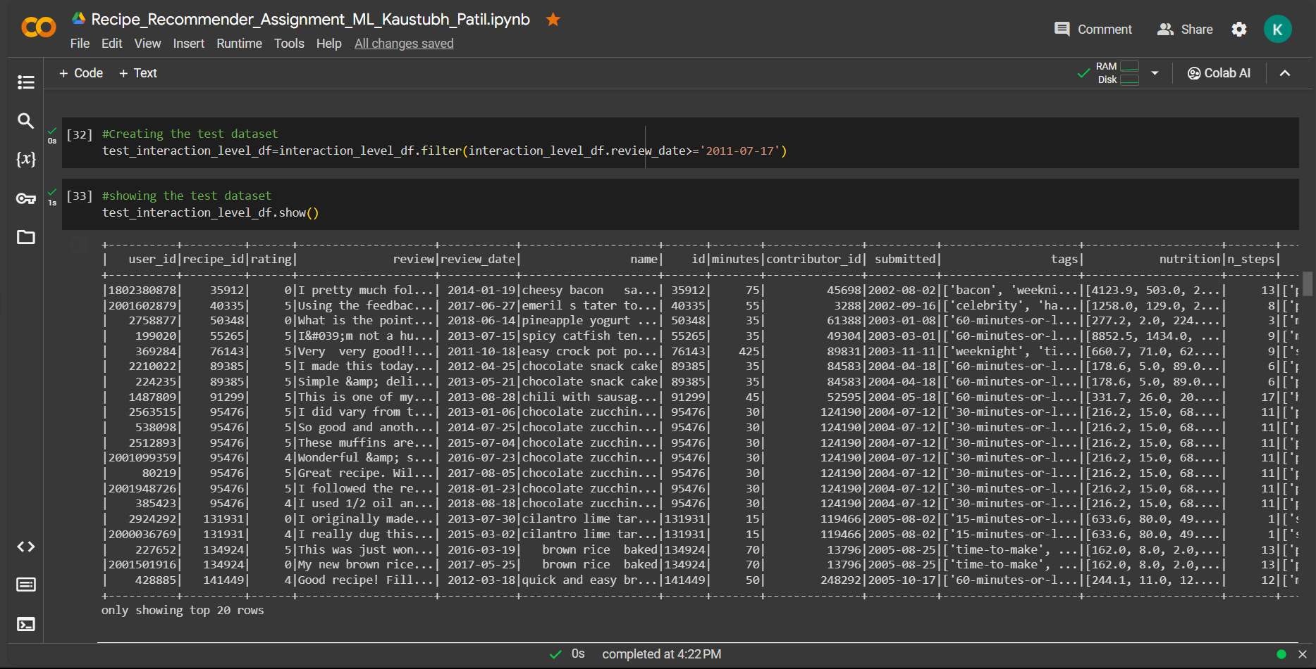
Test Data Set
Output : Test Dataset for testing on the model trained using training dataset

Slide 6
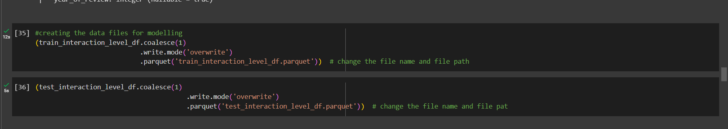
Converting Train and test data in appropriate format for modelling

Slide 7
TASK 2
Collaborative filtering model
Build an ALS-based recommender using the native Spark library.
Create 10 recommendations for each user in the test data.

Slide 8
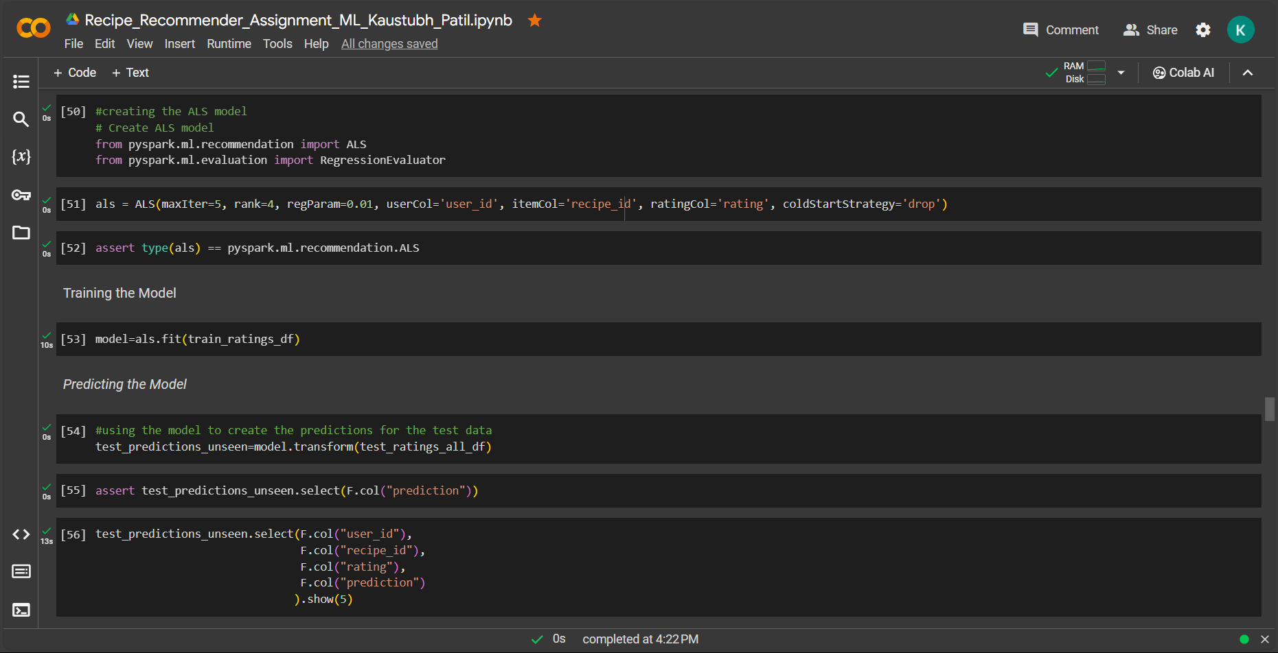
Training and prediction

Slide 9
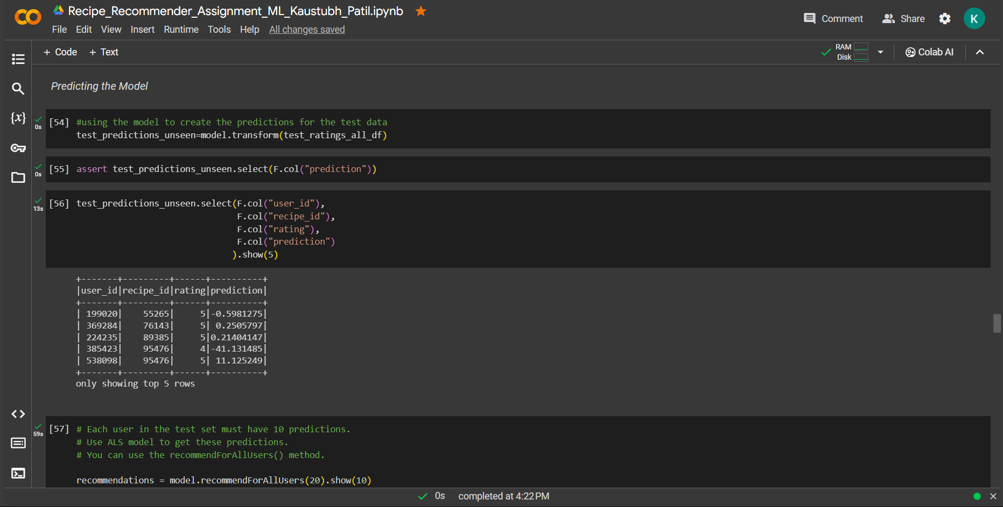
Test Predictions

Slide 10
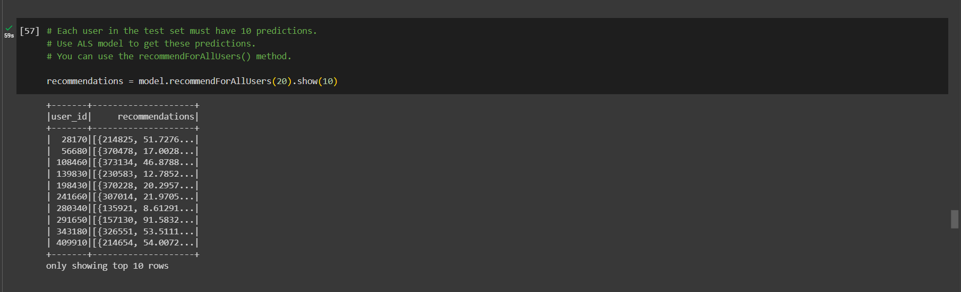
RECOMMENDATIONS
Output : Recommendations for each user ID

Slide 11
TASK 3
Model Evaluation

Slide 12
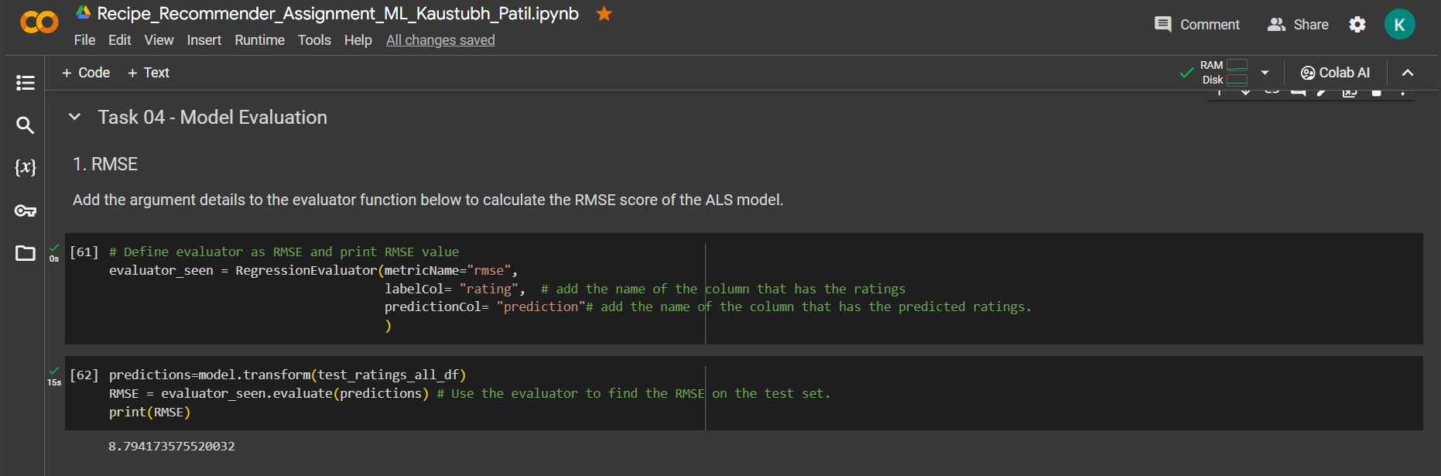
Model evaluation
Output : Model evaluated the rmse value as 8.794173575520032 which is performing quite good.

Slide 13
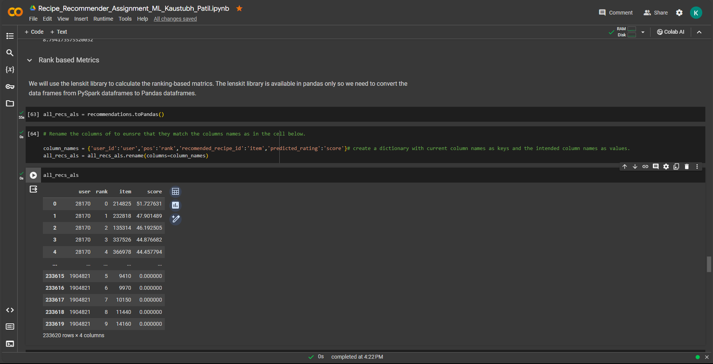
Rank based Metrics
Output : This is a Rank Based evaluation method where we give the rank based on the score or prediction of rating
to be precise for easy understanding.

Slide 14
THANKS
Created by KAUSTUBH PATIL

